Slide 1
Natural Language Processing with Deep Learning
CS224N/Ling284
Christopher Manning and Richard Socher Lecture 1: Introduction

Slide 2
1. What is Natural Language Processing (NLP)?
Natural language processing is a field at the intersection of
computer science
artificial intelligence
and linguistics.
Goal: for computers to process or “understand” natural language in order to perform tasks that are useful, e.g.,
Performing Tasks, like making appointments, buying things
Question Answering
Siri, Google Assistant, Facebook M, Cortana … thank you, mobile!!!
Fully understanding and representing the meaning of language (or even defining it) is a difficult goal.
Perfect language understanding is AI-complete

Slide 3
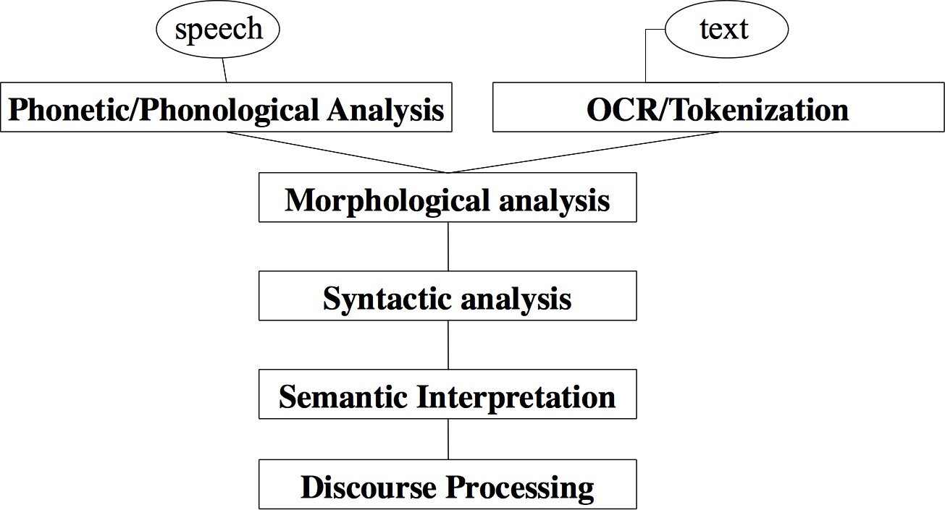
NLP Levels

Slide 4
(A tiny sample of) NLP Applications
Applications range from simple to complex:
Spell checking, keyword search, finding synonyms
Extracting information from websites such as
product price, dates, location, people or company names
Classifying: reading level of school texts, positive/negative sentiment of longer documents
Machine translation
Spoken dialog systems
Complex question answering

Slide 5
NLP in industry … is taking off
Search (written and spoken)
Online advertisement matching
Automated/assisted translation
Sentiment analysis for marketing or finance/trading
Speech recognition
Chatbots / Dialog agents
Automating customer support
Controlling devices
Ordering goods

Slide 6



What’s special about human language?
A human language is a system specifically constructed to convey the speaker/writer’s meaning
Not just an environmental signal, it’s a deliberate communication
Using an encoding which little kids can quickly learn (amazingly!) A human language is a discrete/symbolic/categorical signaling system
rocket = 🚀; violin = 🎻
With very minor exceptions for expressive signaling (“I loooove it.” “Whoomppaaa”)
Presumably because of greater signaling reliability
Symbols are not just an invention of logic / classical AI!

Slide 7
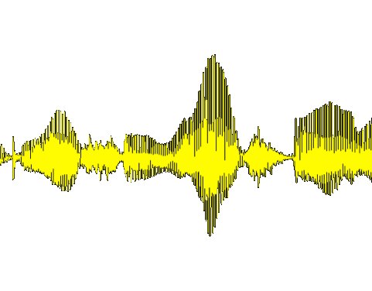
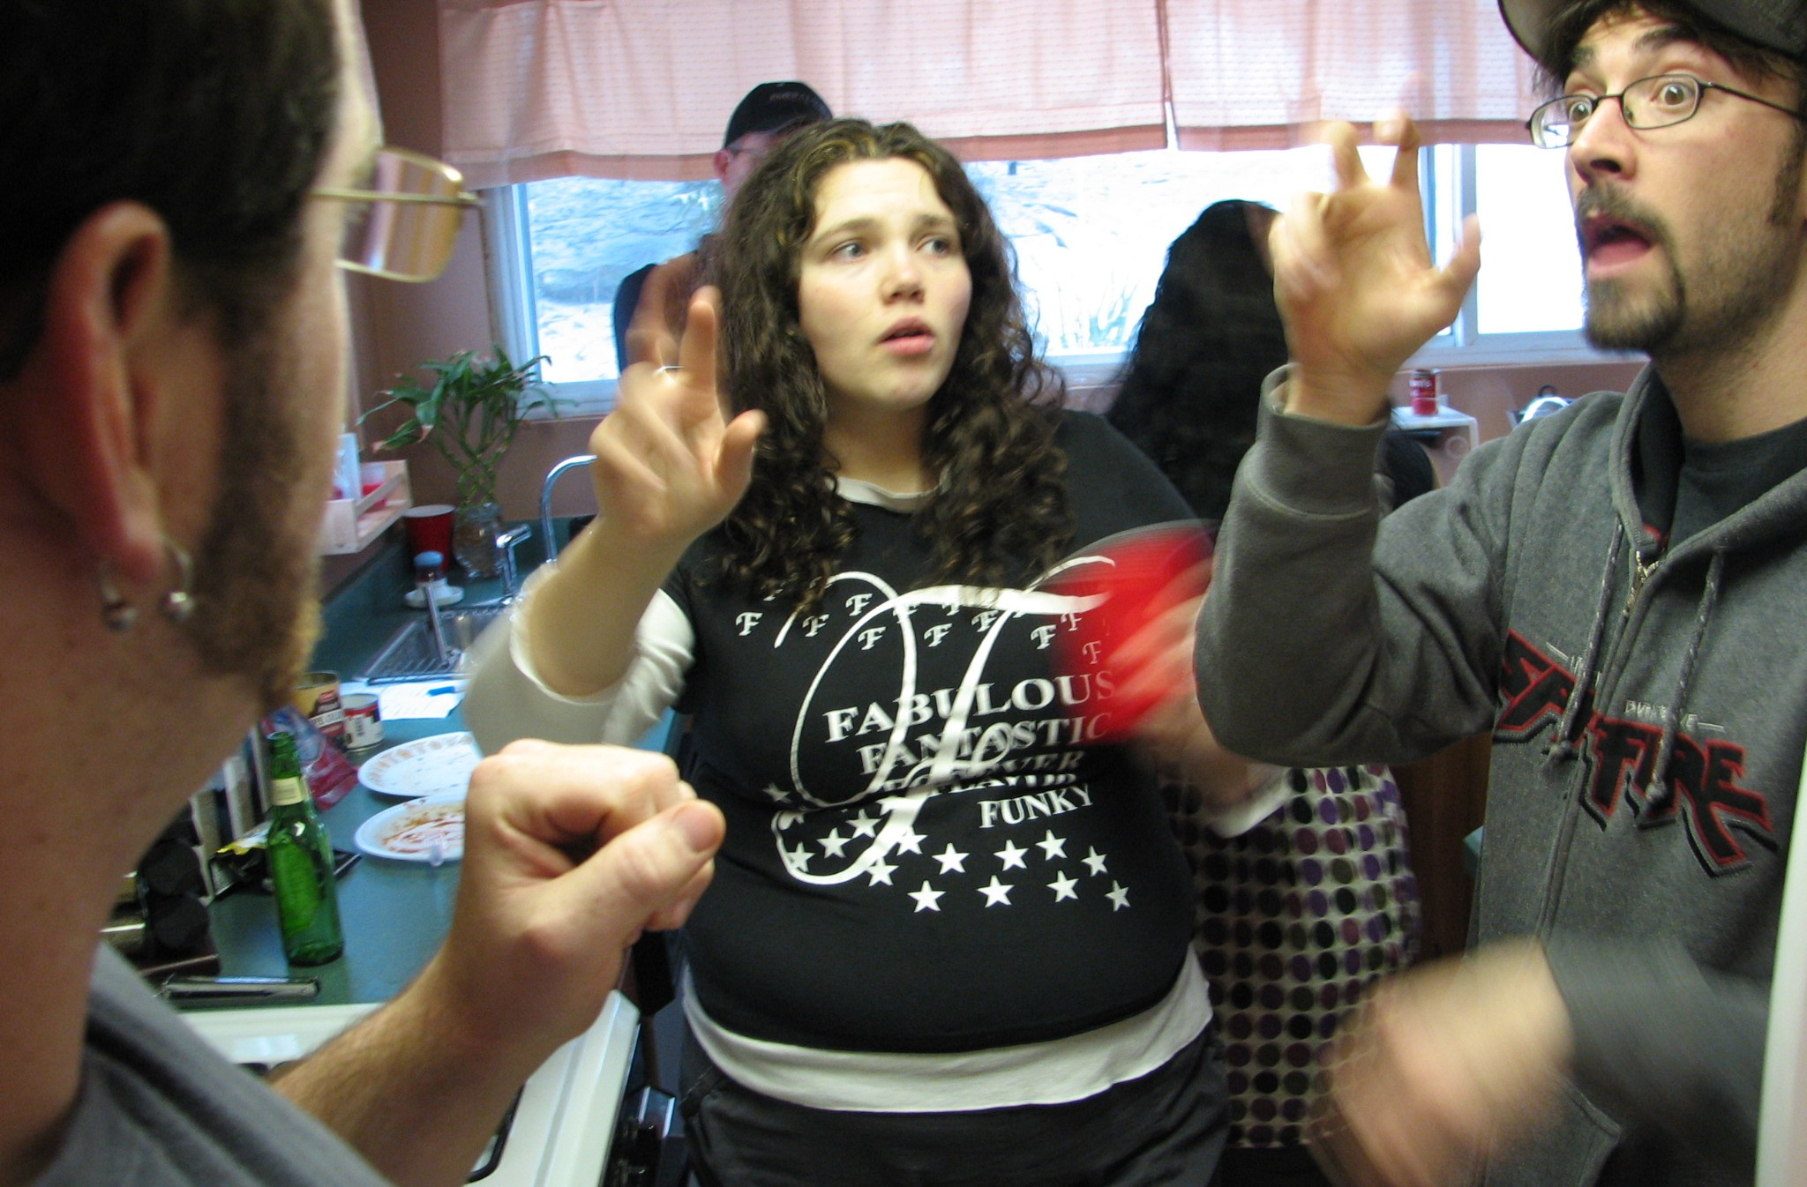

What’s special about human language?
The categorical symbols of a language can be encoded as a signal for communication in several ways:
Sound
Gesture
Images (writing)
The symbol is invariant across different encodings!
CC BY 2.0 David Fulmer 2008
National Library of NZ, no known restrictions

Slide 8
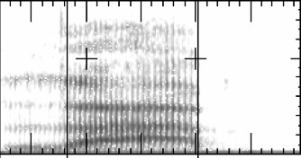
What’s special about human language?
A human language is a symbolic/categorical signaling system
However, a brain encoding appears to be a continuous pattern of activation, and the symbols are transmitted via continuous signals of sound/vision
We will explore a continuous encoding pattern of thought
The large vocabulary, symbolic encoding of words creates a problem for machine learning – sparsity!
lab

Slide 9
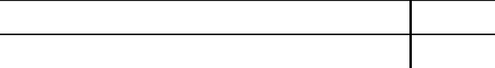
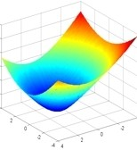
2. What’s Deep Learning (DL)?
Deep learning is a subfield of machine learning
Most machine learning methods work well because of human-designed representations and input features
For example: features for finding named entities like locations or organization names (Finkel et al., 2010):
Feature NER
Current Word C
Previous Word C
Next Word C
Current Word Character n-gram all Current POS Tag C
Surrounding POS Tag Sequence C Current Word Shape C Surrounding Word Shape Sequence C
Presence of Word in Left Window size 4 Presence of Word in Right Window size 4
Machine learning becomes just optimizing weights to best make a final prediction

Slide 10




Machine Learning vs. Deep Learning
Machine Learning in Practice
Describing your data with features a computer can understand
Learning algorithm
Domain specific, requires Ph.D. level talent
Optimizing the weights on features

Slide 11
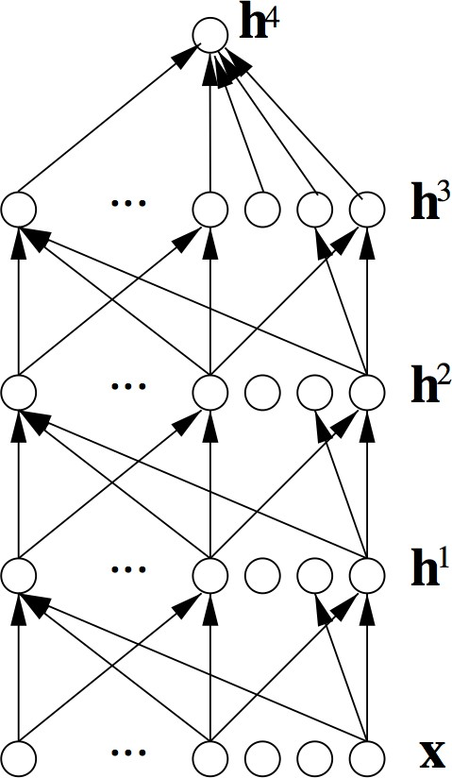
What’s Deep Learning (DL)?
Representation learning attempts to automatically learn good features or representations
Deep learning algorithms attempt to learn (multiple levels of) representation and an output
From “raw” inputs x
(e.g., sound, characters, or words)

Slide 12
Reasons for Exploring Deep Learning
Manually designed features are often over-specified, incomplete and take a long time to design and validate
Learned Features are easy to adapt, fast to learn
Deep learning provides a very flexible, (almost?) universal, learnable framework for representing world, visual and linguistic information.
Deep learning can learn unsupervised (from raw text) and
supervised (with specific labels like positive/negative)

Slide 13
Rise of Deep Learning
In ~2010 deep learning techniques started outperforming other machine learning techniques. Why this decade?
Large amounts of training data favor deep learning
Faster machines and multicore CPU/GPUs favor Deep Learning
New models, algorithms, ideas
Better, more flexible learning of intermediate representations
Effective end-to-end joint system learning
Effective learning methods for using contexts and transferring between tasks
à Improved performance (first in speech and vision, then NLP)

Slide 14
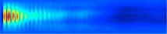
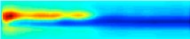
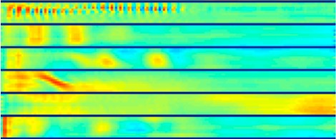
Deep Learning for Speech
The first breakthrough results of “deep learning” on large datasets happened in speech recognition
Context-Dependent Pre-trained Deep Neural Networks for Large Vocabulary Speech Recognition Dahl et al. (2010)
Phonemes/Words
Acoustic model | Recog WER | RT03S FSH | Hub5 SWB
Traditional features | 1-pass −adapt | 27.4 | 23.6
Deep Learning | 1-pass −adapt | 18.5 (−33%) | 16.1 (−32%)

Slide 15
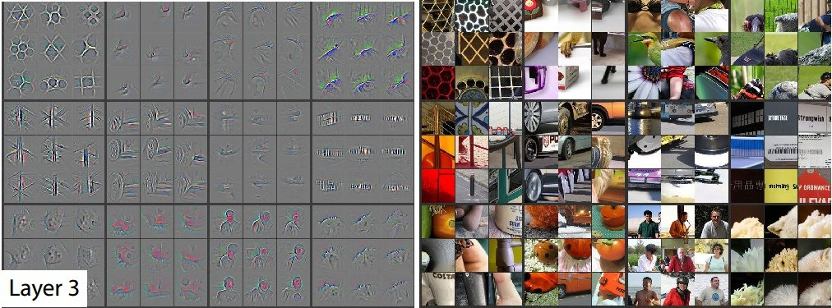
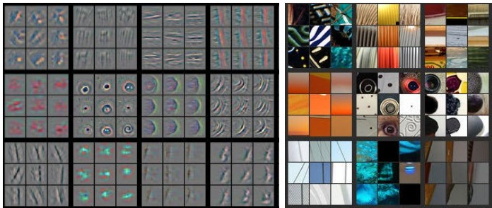
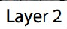
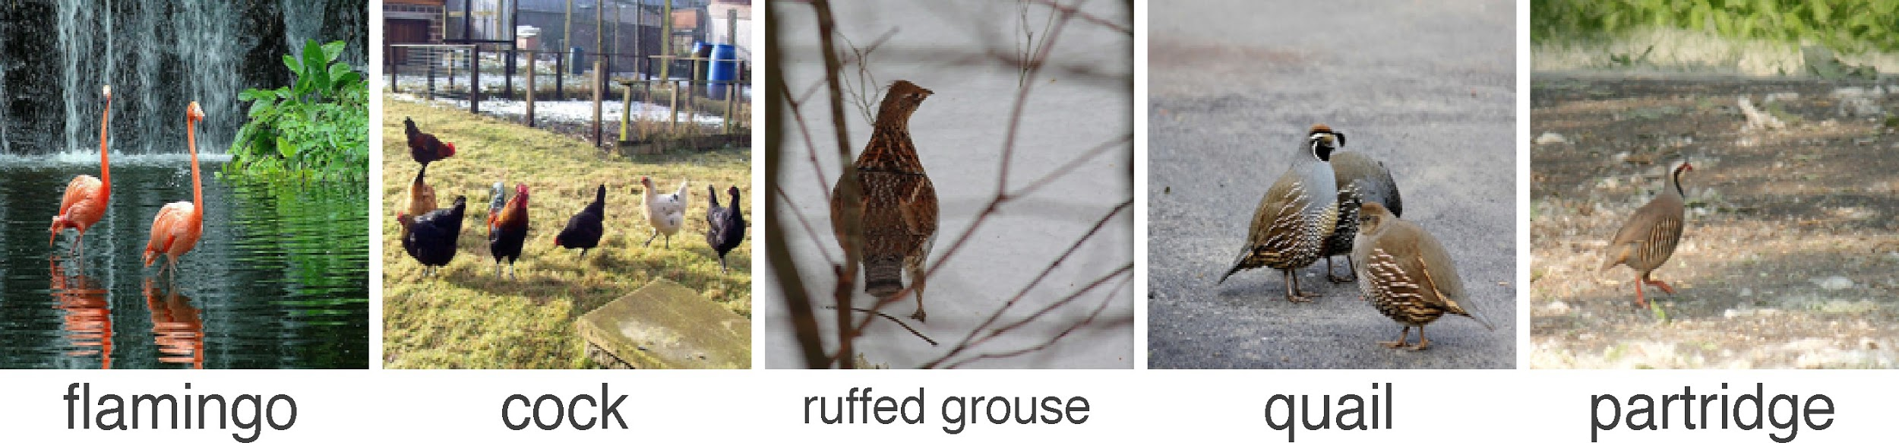
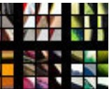
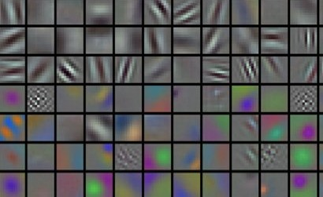
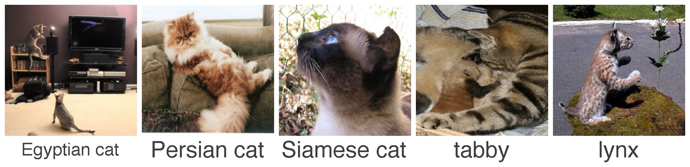
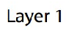
Deep Learning for Computer Vision
Most deep learning groups
have focused on computer vision (at least till 2 years ago)
The breakthrough DL paper: ImageNet Classification with Deep Convolutional Neural Networks by Krizhevsky, Sutskever, & Hinton, 2012, U. Toronto. 37% error red.
···
Zeiler and Fergus (2013)
17
···

Slide 16
Prerequisites
Proficiency in Python
All class assignments will be in Python. (See tutorial on cs224n WWW)
Multivariate Calculus, Linear Algebra (e.g., MATH 51, CME 100)
Basic Probability and Statistics (e.g. CS 109 or other stats course)
Fundamentals of Machine Learning (e.g., from CS229 or CS221)
loss functions,
taking simple derivatives
performing optimization with gradient descent.

Slide 17
4. Why is NLP hard?
Complexity in representing, learning and using linguistic/situational/world/visual knowledge
Human languages are ambiguous (unlike programming and other formal languages)
Human language interpretation depends on real world, common sense, and contextual knowledge

Slide 18
Why NLP is difficult:
Real newspaper headlines/tweets
Visiting relatives can be boring.
This morning I shot an elephant in my pajamas. How he got in my pajamas I don't know.
Scientists study whales from space
Juvenile Court to Try Shooting Defendant

Slide 19
5. Deep NLP = Deep Learning + NLP
Combine ideas and goals of NLP with using representation learning and deep learning methods to solve them
Several big improvements in recent years in NLP with different
Levels: speech, words, syntax, semantics
Tools: parts-of-speech, entities, parsing
Applications: machine translation, sentiment analysis, dialogue agents, question answering

Slide 20
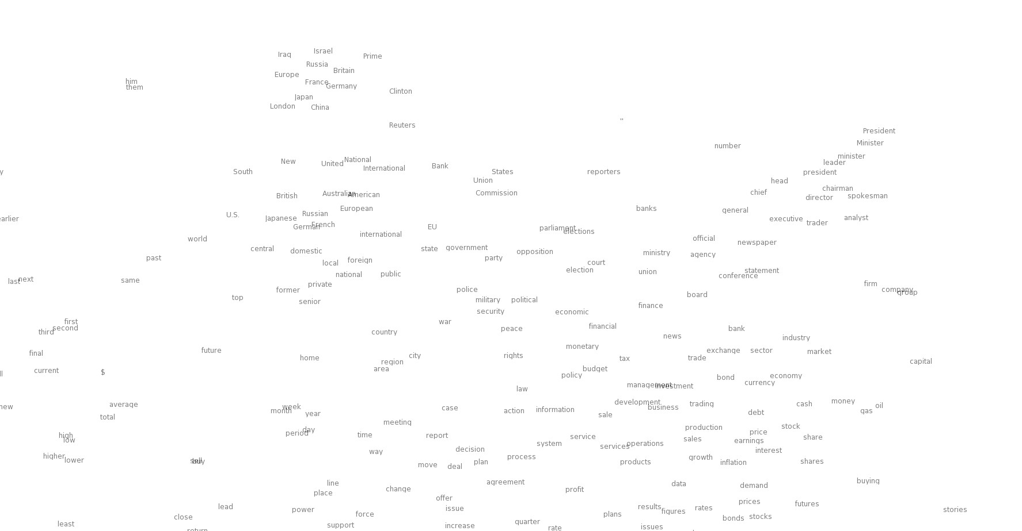

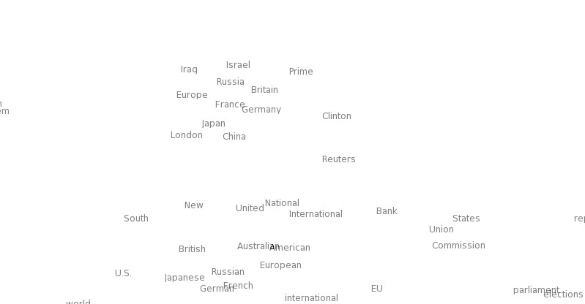
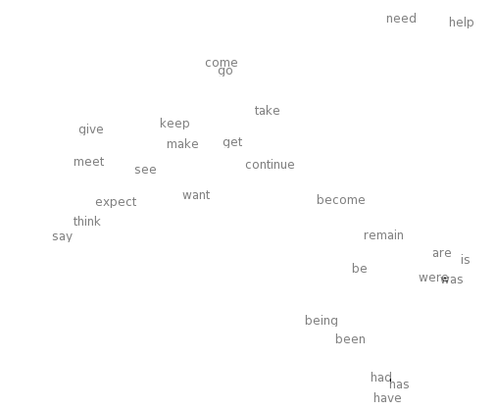
Word meaning as a neural word vector – visualization
0.286
0.792
−0.177
−0.107
0.109
−0.542
0.349
0.271
0.487
expect =

Slide 21
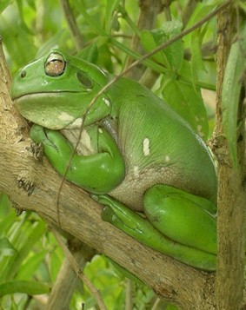
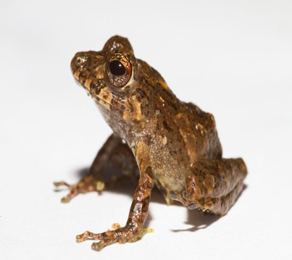
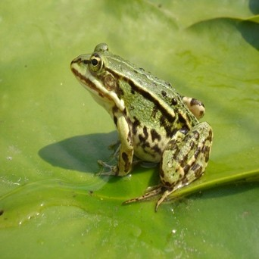
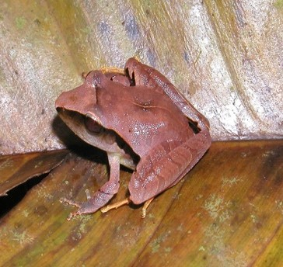
Word similarities
Nearest words to frog:
frogs
toad
litoria
leptodactylidae
rana
lizard
eleutherodactylus
litoria
leptodactylidae
rana http://nlp.stanford.edu/projects/glove/
eleutherodactylus

Slide 22








Representations of NLP Levels: Morphology
Traditional: Words are prefix stem made of morphemes un
suffix
interest ed
DL:
every morpheme is a vector
a neural network combines two vectors into one vector
Luong et al. 2013
unfortunately_{STM}
W , b
m m
unfortunate_{STM}
W_{m}, b_{m}
^{ly}SUF
^{un}PRE
fortunate_{STM}

Slide 23

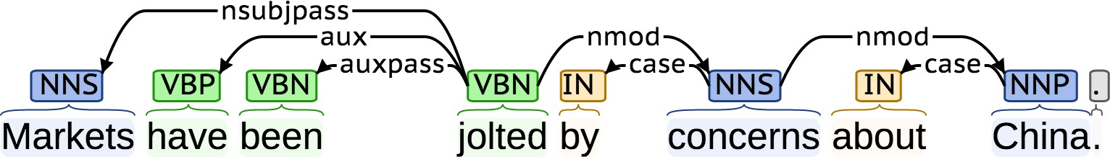
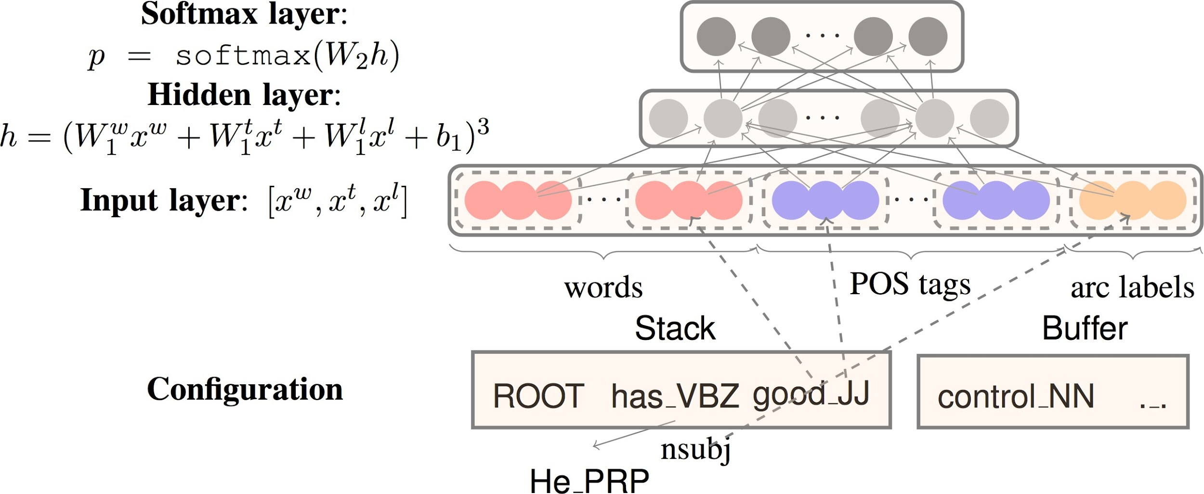
NLP Tools: Parsing for sentence structure
Neural networks can accurately determine the structure of sentences, supporting interpretation

Slide 24
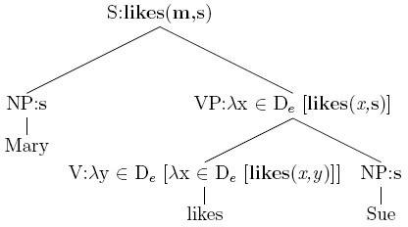
Representations of NLP Levels: Semantics
Traditional: Lambda calculus
Carefully engineered functions
Take as inputs specific other functions
No notion of similarity or fuzziness of language
DL:
Every word and every phrase and every logical expression is a vector
a neural network combines two vectors into one vector
Bowman et al. 2014
Softmax classifier
P (@)= 0.8
Comparison N(T)N layer
all reptiles walk vs. some turtles move
Composition
all reptiles walk
some turtles move
RN(T)N
layers
all reptiles
walk
some turtles
move
all
reptiles
some
turtles

Slide 25
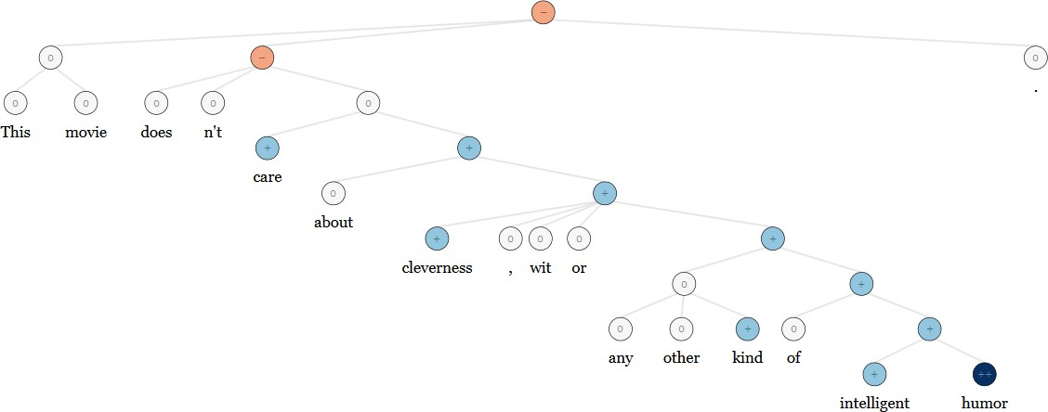
NLP Applications: Sentiment Analysis
Traditional: Curated sentiment dictionaries combined with either bag-of-words representations (ignoring word order) or hand- designed negation features (ain’t gonna capture everything)
Same deep learning model that was used for morphology, syntax and logical semantics can be used à RecursiveNN

Slide 26
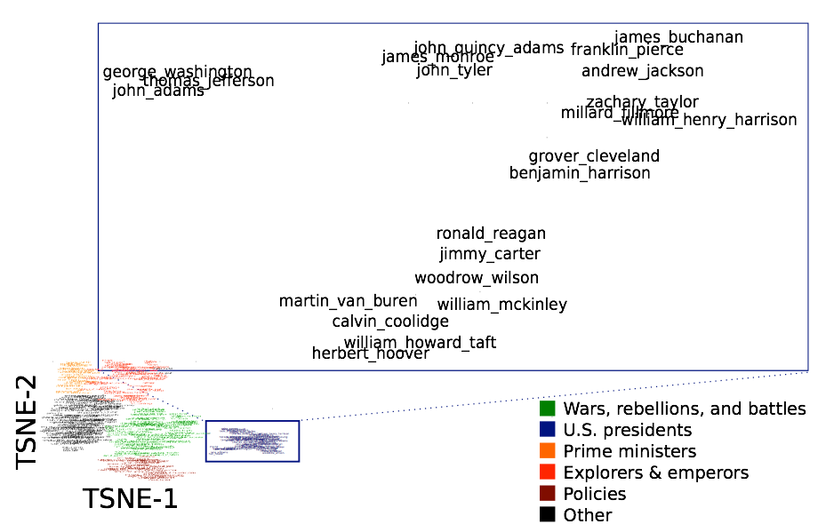
Question Answering
Traditional: A lot of feature engineering to capture world and other knowledge, e.g., regular expressions, Berant et al. (2014)
Is main verb trigger?
Yes
No
Condition | Regular Exp.
Wh- word subjective? Wh- word object? | AGENT THEME
Condition | Regular Exp.
default DIRECT PREVENT | (ENABLE|SUPER)⁺ (ENABLE|SUPER) (ENABLE|SUPER)⇤PREVENT(ENABLE|SUPER)⇤
DL: Again, a deep learning architecture can be used!
Facts are stored in vectors

Slide 27
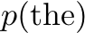
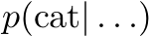
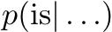
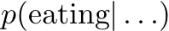
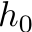
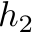
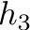
Dialogue agents / Response Generation
A simple, successful example is the auto-replies available in the Google Inbox app
An application of the powerful, general technique of Neural Language Models, which are an instance of Recurrent Neural Networks

Slide 28
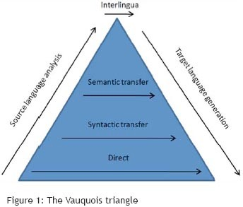
Machine Translation
Many levels of translation have been tried in the past:
Traditional MT systems are very large complex systems
What do you think is the interlingua for the DL approach to translation?

Slide 29
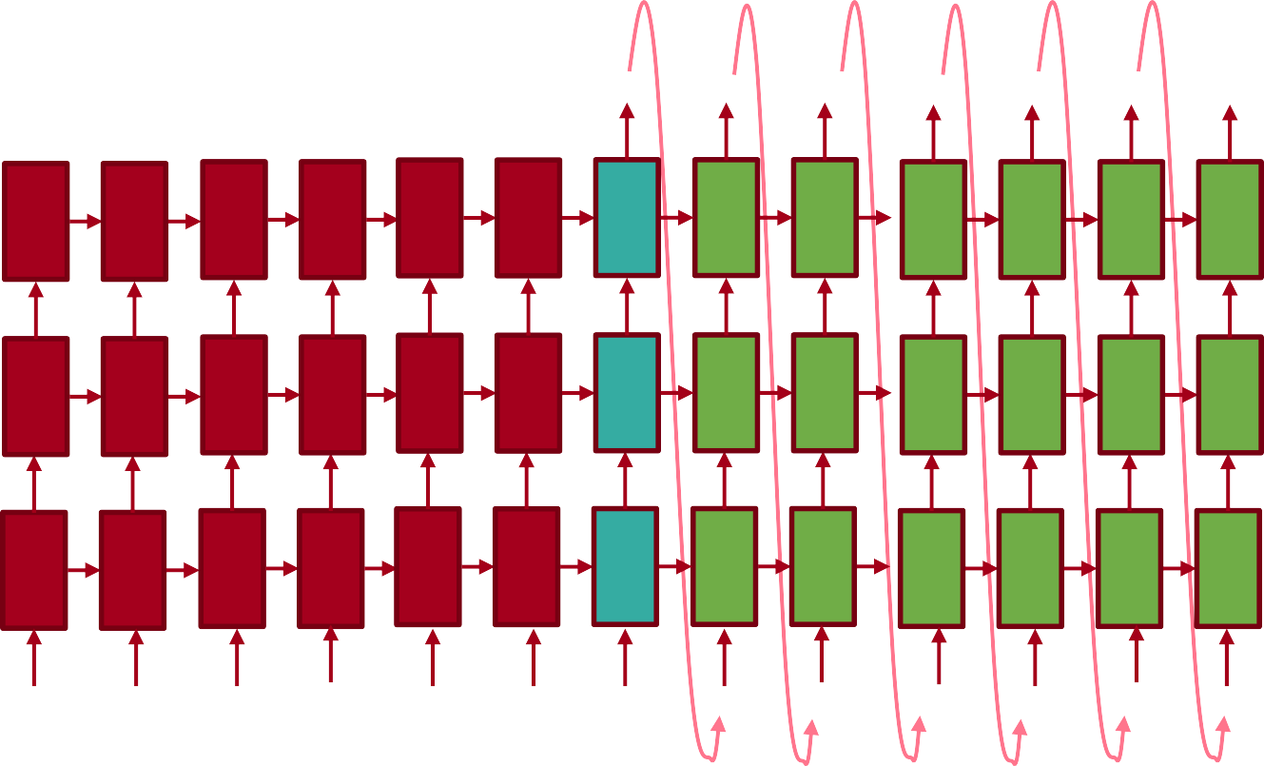
Neural Machine Translation
Source sentence is mapped to vector, then output sentence generated [Sutskever et al. 2014, Bahdanau et al. 2014, Luong and Manning 2016]
Translation generated
The protests escalated
over
the weekend <EOS>
0.1 | 0.2 | 0.4 | 0.5 | 0.2 | -0.1 | 0.2 | 0.2 | 0.3 | 0.4 | -0.2 | -0.4 | -0.3
0.3 | 0.6 | 0.4 | 0.5 | 0.6 | 0.6 | 0.6 | 0.6 | 0.6 | 0.4 | 0.6 | 0.6 | 0.5
0.1 | -0.1 | 0.3 | 0.9 | -0.1 | -0.1 | -0.1 | -0.1 | -0.1 | -0.1 | -0.1 | -0.1 | -0.1
-0.4 | -0.7 | -0.2 | -0.3 | -0.5 | -0.7 | -0.7 | -0.7 | -0.7 | -0.7 | -0.7 | -0.7 | -0.7
0.2 | 0.1 | -0.3 | -0.2 | 0.1 | 0.1 | 0.1 | 0.1 | 0.1 | 0.1 | 0.1 | 0.1 | 0.1
Sentence meaning is built up
0.2 -0.2 | 0.2 0.6 | 0.1 0.3 | 0.2 0.6 | 0.2 -0.8 | 0.2 0.6 | 0.2 -0.1 | -0.4 0.6 | 0.2 0.6 | -0.1 0.6 | 0.2 0.4 | 0.3 0.6 | 0.2 0.6
-0.1 0.1 | -0.1 -0.7 | -0.1 -0.7 | -0.1 -0.4 | -0.1 -0.5 | -0.1 -0.7 | -0.1 -0.7 | -0.1 -0.7 | -0.1 0.3 | -0.1 0.3 | -0.1 0.2 | -0.1 -0.5 | -0.1 -0.7
0.1 | 0.1 | 0.1 | 0.1 | 0.1 | 0.1 | 0.1 | 0.1 | 0.1 | 0.1 | 0.1 | 0.1 | 0.1
0.2 | 0.4 | 0.2 | 0.2 | 0.4 | 0.2 | 0.2 | 0.2 | 0.2 | -0.1 | -0.2 | -0.4 | 0.2
0.6 | -0.6 | -0.3 | 0.4 | -0.2 | 0.6 | 0.6 | 0.6 | 0.6 | 0.3 | 0.6 | 0.5 | 0.6
-0.1 | 0.2 | -0.1 | 0.1 | -0.3 | -0.1 | -0.1 | -0.1 | -0.1 | -0.1 | 0.1 | -0.5 | -0.1
-0.7 | -0.3 | -0.4 | -0.5 | -0.4 | -0.7 | -0.7 | -0.7 | -0.7 | -0.7 | 0.3 | 0.4 | -0.7
0.1 | 0.4 | 0.2 | -0.2 | -0.2 | 0.1 | 0.1 | 0.1 | 0.1 | 0.1 | 0.1 | 0.1 | 0.1
Source sentence
Die Proteste waren am Wochenende eskaliert <EOS>
The protests escalated over
the weekend
Feeding in last word
Now live for some languages in Google Translate (etc.), with big error reductions!

